Slide 1
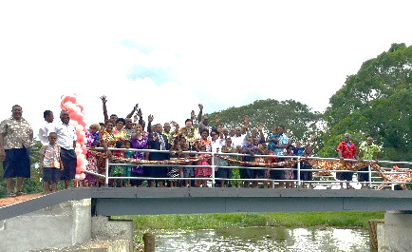
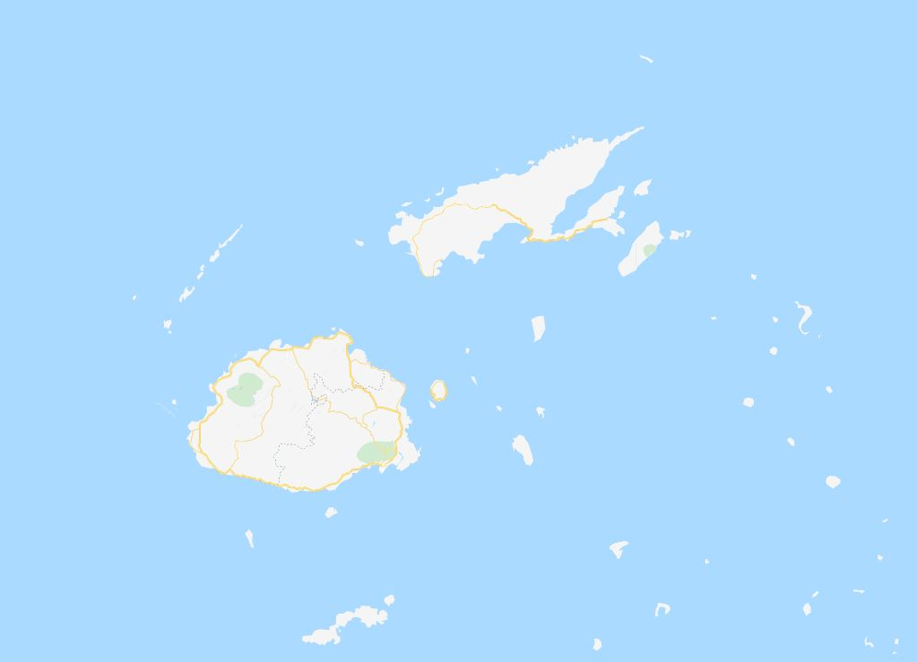
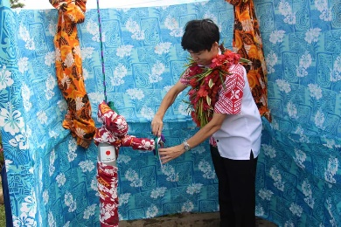
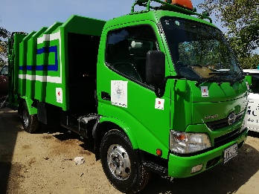
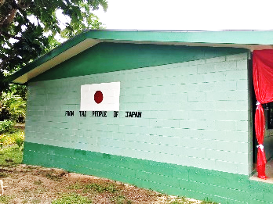
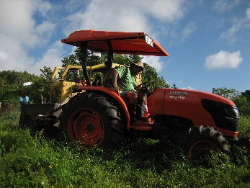
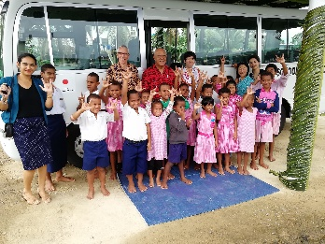
FIJI GGP PROJECT MAP 1990-2019
Rotuma
4
Central: 163
Western: 116
Northern: 71
Eastern: 35
Nationwide: 13
Macuata
35
Rabi
2
Bua
9
Cakaudrove
14
387 projects
USD 26,866,630 approx. FJD 55 million
Yasawa
7
Taveuni
11
Grant Assistance for Grass-roots Human Security Projects
Ra
16
Lomaiviti
24
Ba
67
NAITASIRI,
NAMOSI,
SERUA
31
Tailevu
27
Lau
7
Bula! I’m Grass-Kitty. You can find our projects almost everywhere in Fiji!
NADROGA,
NAVOSA
26
Rewa
44
Suva
51
Beqa
3
Kadavu
7
在フィジー日本国大使館
Embassy of Japan in the Republic of Fiji
*The total number of projects in each area does not match the total number of projects because some projects ware conducted in multiple regions.
219
32
90
36
8
Education
Water
Environment/Health
Transportation
Agriculture/Fishery

Slide 2
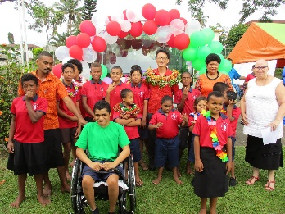
SUVA 51
Central division 1
Grass-roots Radio for Pacific Women (1990)
Suva Society for the Intellectually Handicapped “Mini-bus” (1991)
Replacement of Simultaneous Interpretation and Conference System (1991)
Transport for Fiji Society for the Blind (1992)
Project of Transport for the Fiji Crippled Children Society (1993)
The Forum Secretariat, Provision of Computer Systems for Training (1993)
Forest Dept. MAFF, Project of Management Survey of Native Rainforest (1993)
Project of Audio Visual Resources for Primary & Secondary Schools (1994)
The Forum Secretariat, Project of Equipment for Conference Centre (1994)
Project of Transport for the Fiji Rehabilitation Council (1994)
Project of Transportation and Equipment for the Workshop on Environment (1994)
Fiji Red Cross Society, Project of Blood Donor Service Vehicles (1994)
Community Education & Training Centre Upgrading Project (SPC) (1996)
St. Giles Psychiatric Hospital Vehicle Project (1997)
Women in Development/Home Economics Training and Equipment Upgrading Project (SPC) (1997)
Women's Action for Change - Community Theatre Vehicle & Equip. Project (1997)
St. Giles Psychiatric Hospital Education and Training Centre Project (1997)
Establishment of a Computer Training Facility of Fiji Islands Media Association (FIMA) (1997)
Fiji School of Medicine, Project for Provision of Dental Training Equipment (1998)
Upgrading Project for Hilton Special School (1998)
Suva City Library Upgrading Project (1998)
Maintenance & Upgrading Project for Hostel at Fiji Blind School (1998)
Upgrading for Fiji Vocational Council (1999)
Upgrading Suva School for Intellectually Handicapped (2000)
Community Education Training Center of Pacific Community (2001)
Champagnat Institute Classroom Construction Project (2001)
Communications Link to Marine Studies Complex Project (2001)
Upgrading of Training Center of St. John's Ambulance (2001)
Bus for Gospel School for the Deaf (2002)
Ambulance for St John Ambulance (2000, 2002)
Provision of Computers to Secondary Schools (2002)
Mead Road Community Hall Upgrading Project (2002)
Compactor Garbage Truck for Suva City (2003)
Fire Truck for NFA (2003)
Provision of Motorcycles to Fiji Police (2003)
Upgrading of Fiji Police Network System (2003)
Medical Equipment for CWM Hospital (2004)
Provision of Bus to Fiji School for the Blind (2004)
School Bus for The Handicapped Vocational & Technical Training Centre (2005)
Second Hand Ambulances for Viti Levu Island (2006)
Upgrading of Suva Muslim College (2007)
Upgrading of Vatuwaqa Primary School (2010)
Medical Equipment for National Rehabilitation Medicine Hospital (2010)
Blood Donation Bus for Fiji National Blood Service (2011)
Upgrading the Compost Centre in Suva City (2012)
Upgrading of Home of Compassion Nursing Care Facility for Old and Disabled People (2013)
Upgrading of Homes of Hope Training Centre (2015)
Upgrading of Facilities for Children with Disabilities in Hilton Organization (2016)
Provision of School Bus to Gospel School for the Deaf (2017)
Provision of School Bus to Suva Special School (2017)
Upgrading of Saint Anne’s Primary School (2019)

Slide 3
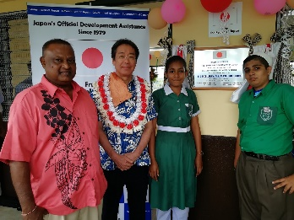
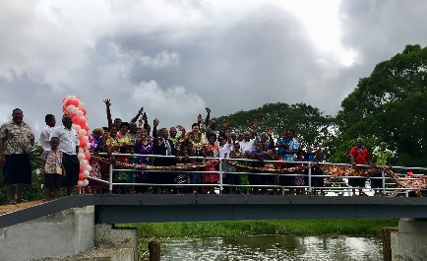
REWA 44
Central division 2
Rewa
Motor vehicle for Rehabilitation(1992)
Pacific Agricultural Information System (1992)
Provision of Refuse Truck for Lami Town Council (1996)
Science Laboratory Upgrading Project for Dilkusha Methodist High School (1998)
Upgrading for Burebasaga District School (1999)
Upgrading for Jyoti Assembly Kindergarten (1999)
Upgrading of Vutia District School (2003)
Upgrading of Saraswati Primary School (2004)
Upgrading of Sanatan Dharm Primary School (2004)
Upgrading of Chauhan Memorial School (2004)
Provision of Garbage Compactor Truck to Nausori Town Council (2004)
Provision of Poultry Sheds for Naboro Prisons (2005)
Upgrading of Vunimono High School (2005)
Provision of Garbage Truck to Lami Town Council (2006)
Upgrading of Nakasi High School (2006)
Upgrading of Saraswati Primary Monoca School (2006)
Provision of Model Plant for TPAF (2006)
Upgrading of Makoi Muslim Primary School (2007)
Upgrading of Nausori High School (2007)
Upgrading of Nasinu Sangam School (2007)
Upgrading of Nausori Primary School (2007)
Provision of Ambulance to Nausori Hospital (2007)
Upgrading of Nakaikogo Sanatan Dharm School (2008)
Upgrading of St John Bosco Primary School (2008)
Upgrading of Toga District School (2008)
Upgrading of Vuci Methodist School (2008)
Rehabilitation of Tavuya Village Bridge (2008)
Upgrading of Rambisessar Chaudhary Memorial Primary School (2008)
Provision of Backhoe to Nasinu Town Council (2009)
Upgrading of Rishikul Primary School (2009)
Upgrading of Rishikul Nadera Primary School (2009)
Upgrading of Bishop Kempthorne Memorial School (2009)
Renovation of Vunimono Islamia Primary School (2011)
Renovation of St. Joseph the Worker Primary School (2011)
Renovation of Dilkusha Methodist High School (2012)
Empowerment of Single Mothers and Their Children (2012)
Improving Sanitary Environment in Nasinu (2013)
Provision of Garbage Truck to Nausori Town Council (2015)
Upgrading Nausori Special School (2017)
Provision of Garbage Compactor Truck to Nasinu Town (2017)
Upgrading of Waidra Muslim Primary School (2017)
Provision of Materials for Tilapia Seed Production to Naduruloulou Research Station (2018)
Construction of Foot Bridge to Visama Village (2018)
Upgrading of Nasinu Gospel Primary School (2018)

Slide 4
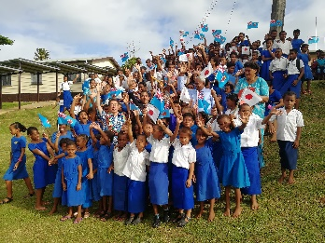
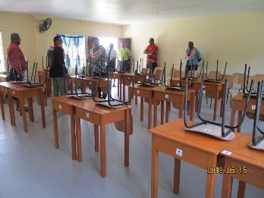
TAILEVU 27
Central division 3
BEQA 3
Central division 4
Tailevu
Nakalawaca Suspension Bridge (1990)
Korovou Bridge (1991)
Tailevu North High School Electrification Project (1995)
Provision of Agricultural Equipments for Christian Youth Development Association (1995)
Qoma Island Water Supply Project (1996)
Nailagatabua Primary School Power Generator Project (1997)
Krishna Vadek Primary School Rehabilitation Project (1997)
Saraswati Primary School Furniture (1999)
Upgrading Rokotuivatu District School (2000)
Upgrading Wailotua District School (2000)
Upgrading Cautata District School (2000)
Waidalice Dist. School Water Supply (2001)
Upgrading Project for Lawaki District School (2002)
Upgrading of Ratu Ravuama Vunivalu School (2003)
Upgrading of Waidra Muslim Primary School(2007)
Upgrading of Lodoni Primary School (2007)
Upgrading of Ramakrishna Mission School (2007)
Upgrading of Delainakaikai Primary School (2009)
Water Supply to Lawaki Village (2010)
Water Supply to Namena Village (2011)
Improvement of Sanitation Environment in Ucunivanua Village (2012)
Rehabilitation of Lawaki District School (2017)
Rehabilitation of Namena District School (2017)
Rehabilitation of Vunibokoi District School (2017)
Upgrading of Bau District Primary School (2018)
Upgradinig of Naivicula District School (2019)
Improving Sanitation Environment of Nausori Primary School (2019)
1. Upgrading for Raviravi/Rukua District School (2000)
2. Upgrading of Infrastructure in Dakuibeqa Village (2000)
3. Water Supply to Nawaisomo Village (2012)
Veqa

Slide 5
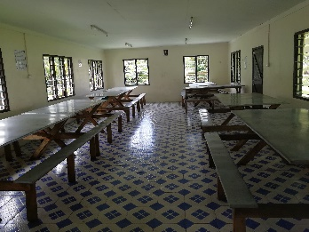
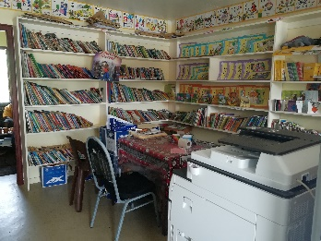
NAITASIRI,NAMOSI
SERUA 31
Central division 5
KADAVU 7
Central division 6
Naitasiri
Namosi
Serua
Construction of Two-classrooms Building for Lutu District School (1995)
Nagali District School Water Supply Project (1996)
Nakorosule District School Upgrading Project (1996)
Hostel Upgrading for Naivucini District School (1999)
Upgrading for Vunidawa District School (1999)
Upgrading of Naduna Primary School (2004)
Provision of Ambulance to Vunidawa Hospital (2004)
Water Supply for Delaitoga Village (2006)
Upgrading of Naitasiri Bhartiya School (2008)
Upgrading of Rara District School (2009)
Water Supply to Taulevu Village (2010)
Upgrading of Lomaivuna Settlement Primary School (2010)
Upgrading of Vunidawa Indian School (2010)
Renovation of Lomaivuna Settlement High School (2011)
Renovation of Nairukuruku District Primary School (2012)
Renovation of Natoaika Village Primary School (2012)
Wainilotulevu/Nasoqo and Primary School Water Supply Project (1995)
Naqarawai Village Suspension Bridge Project (1996)
Upgrading of Chevalier Farm Youth Training Center (2001)
Upgrading Project for Rampur College (2002)
Upgrading of Burenitu Village School (2004)
Rehabilitation of Navua Hospital (2004)
The Project for Upgrading of Lomary Catholic Primary School (2008)
Upgrading Namosi Catholic Primary School (2015)
Upgrading of Chevalier Training Centre (2015)
Upgrading of Coloi-Naivakacere Primary School (2018)
Upgrading Navuakece District School (2018)
Upgrading of Kalabu Primary School (2019)
Upgrading of Jeremiah Raivebu College (2019)
Upgrading of Adi Cakobau School (2019)
Upgrading of Nakaidrau Infant School (2019)
Jioma Footcrossing Bridge Project (1995)
Galoa Village School Upgrading Project (1996)
Upgrading Eliki Memorial School (2000)
Upgrading Nakasaleka District School (2000)
Bridge Constraction Nabouwalu Villa (2000)
Water Supply to Yavitu (2004)
Water Supply to Natumua Village (2012)
Kadavu

Slide 6
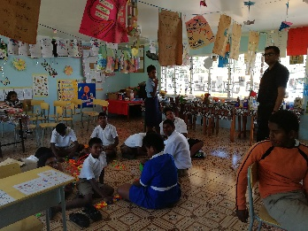
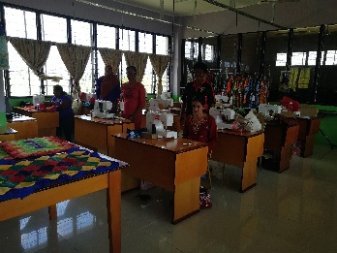
BA 67 part1
Western division 1
Ba
Two-classroom Building for Nawaka District School (1995)
Ba Sangam College Toilet Block Project (1995)
Ratu Filimoni Vukinamualevu Memorial School Rehabilitation Project (1997)
Nacasi Hindu School Rehabilitation Project (1997)
Ba Methodist High School Dormitory Upgrading Project (1997)
Upgrading of Natabua Old People's Home (1997)
Naviyago-Vitogo Bridge Construction (1997)
Provision of Insect Protection Screening for Medical Organizations in Fiji (1997)
Drought Relief Project in Fiji (1998)
Upgrading Project for Western Disabled Peoples Association (1998)
Emergency Power Supply System Installation for Nadi District Hospital (1998)
Rehabilitation Project on Schools Damaged by 1999 Flood in Fiji (1998)
Rehabilitation of Naviyago-Vitogo Bridge (1998)
Emergency Power Supply System Installation for Tavua Hospital (1999)
Upgrading for Buruwa Youth Memorial Primary School (1999)
Sabeto Muslim Primary School (1999)
Nadi Center for Special Education for Construction of Vocational Training WS (1999)
Improving Sanitary Environment in Ba (1999)
Provision of Equipment for CTV (1999)
Upgrading CTV studio (2000)
Upgrading of Lautoka School for Intellectually Handicapped (2001)
Ba town Library Construction Project (2001)
Nawaicoba Vocational Center Upgrading (2001)
Upgrading of Lovu Sangam School (2001)
Improving Sanitary Environment in Tavua (2004)
Provision of Fire Trucks to the National Fire Authority
Upgrading of Toko Bhartiya School (2005)
Upgrading of Balata High School (2005)
Workshops for Mulomulo Secondary School Technical & Vocational Centre (2005)
Upgrading of Maigania Muslim Primary School (2005)
Upgrading of Varavu Muslim School (2005)
Upgrading of Votualevu College (2006)
Upgrading of Korovuto Primary School (2006)
Provision of Second Hand Ambulances for Ba Methodist Mission Hospital (2006)
Medical Equipment for Lautoka Hospital (2007)
Upgrading of Jasper Williams Primary School (2007)
Upgrading of Koronubu Indian School (2009)
Upgrading of Nukuloa College (2009)
Promotion of Green Waste Minimization and Recycling in Nadi Town (2010)
Provision of Disability Bus to Western Disabled People's Association (2010)

Slide 7
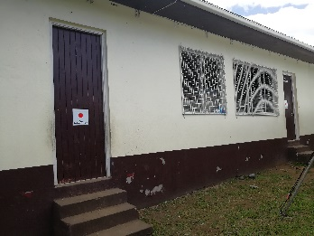
BA 67 part2
Western division 1
Ra
RA 16
Western division 2
Ba
Renovation of Lautoka Primary School (2011)
Procurement of Disability Bus to Lautoka School for Special Education (2011)
Reconstruction of Naviyago Bridge (2012)
Provision of Mini Excavator to Nadi Town (2012)
Renovation of Votua Catholic Primary School (2012)
Vitogo District School (2012)
Cyclone Rehabilitation for Vakabuli Primary School (2013)
Construction of Lautoka Fish Market (2013)
Assisting Relocation of Nakoroboya Primary School (2013)
Installing Flood Early Warning Devices in the Western Division (2013)
Community Learning Centre for Nalotawa District School (2014)
Provision of Blood Donor Bus for the Western Division (2014)
Ba Women’s Training Centre Construction (2014)
Provision of School Bus to Sunshine Special School (2015)
Upgrading of Lovu Sangam School (2015)
Upgrading of Nadi Centre for Special Education (2015)
Provision of Garbage Truck to Nadi Town (2015)
Upgrading of Lautoka Andhra Sangam College (2015)
Upgrading of Ba Provincial Free Bird Institute (2015)
Rehabilitation of Koronubu Sangam School (2016)
Rehabilitation of Toko Sanatan Primary School (2016)
Rehabilitation of Balevuto Public School (2016)
Provision of Garbage Truck to Lautoka City (2017)
Provision of Garbage Truck to Lautoka City (2017)
Rehabilitation of Varavu Sanatan Dharam School (2017)
Rehabilitation of Votua Catholic Primary School (2017)
Water Supply to Tubenasolo Village (2017)
Construction of Two-classroom Building for Bureiwai District School (1995)
Madhuvani Water Supply Project (1995)
Tataiya Memorial School Upgrading Project (1996)
Ra Special School Upgrading Project (1996)
Ra High School Construction Project (1997)
Nanuku Sangam Primary School Upgrading Project (1998)
Barotu District Water Supply Project (2000)
Bridge Construction for Nausori Village (2000)
Bridge Construction for Naqelewai (2000)
Rehabilitation for Naria Bhartiya School (2000)
Water Supply for Vunitogoloa (2003)
Upgrading of Disaster Broadcasting Transmission Stations of FBCL (2005)
Water Supply to Rokovuaka Village (2011)
Water Supply for 5 Villages in Ra Province (2013)
Water Supply for Cavucavu Settlement (2014)
Ambulance for Ra Maternity Hospital (2014)

Slide 8
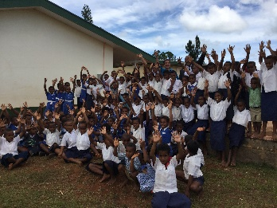
NADROGA NAVOSA 26
Western division 3
Nadroga
Navosa
YASAWA 7
Western division 4
Conua District Water Supply Project (1996)
OISCA Training Centre Agricultural Training Equipment Upgrading Project (1996)
Waicoba Village & Sigatoka Valley Junior Secondary School Water Supply Project (1996)
OISCA Pottery Training Equipment (1998)
Children's Forest Program Equipment (1999)
Upgrading for Schools, Benama (1999)
Training Project for Youth Aquaculture & Rice Farming (2001)
Andhra High School Automotive Engineering Workshop Project (2002)
Backhoe for Sigatoka Town Council (2007)
Upgrading of Lomawai Secondary School and Vocational Centre (2008)
Water Supply for Vadraya & Jafau (2008)
Water Supply for Nalebaleba Village (2008)
Provision of Ambulance to Sigatoka Hospital (2009)
Water Supply to Nadrala Village(2009)
Water Supply to Sautabu Village(2010)
Upgrading of Naidovi Indian School (2010)
Flood Prevention Project for Schools in Nadroga Navosa Province (2012)
Upgrading of Sigatoka Valley High School (2013)
Bus for Sigatoka School for Special Education (2014)
Upgrading of Waicoba District School (2014)
Reconstruction of Classrooms Damaged by Fire at Sigatoka Methodist Primary School (2014)
Rehabilitation of Navatusila District School(2016)
Water Supply to Naga Village (2017)
Upgrading of Tagaqe District School (2019)
Upgrading of Sigatoka District School (2019)
Water Supply to Vatukarasa Village and Nakorovou Village (2019)
Outer Island Primary School Dining Room Construction (1991)
Bouwaqa District School Water Project (1995)
Desalination Equipment Installation Project on Water Supply Boats (1998)
Naviti Island Water Supply Project (2014)
Water Supply to Soso Village (2015)
Construction of Nalawaki Village Spring Box (2015)
Rehabilitation for WaterSupply to Naviti (2016)
Yasawa

Slide 9
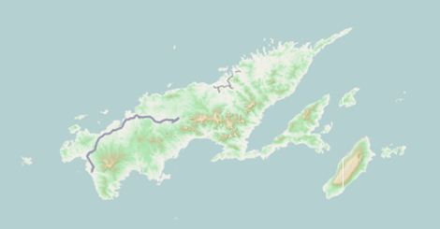
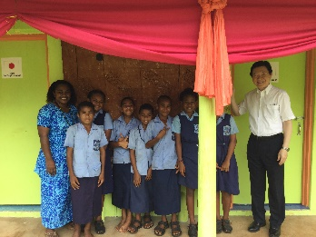
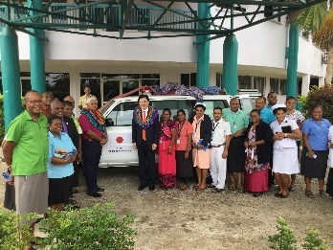
Labasa
Rabi
Macuata
MACUATA 35
Northern division 1
Bua
Cakaudrove
BUA 9
Northern division 2
Savusavu
Taveuni
Nabouwalu
Labasa Food Garden and Nutrition Service Centre (1992)
Woodwork Shop Construction Project of Labasa School for the Handicapped (1997)
Anti-Mosquito Equipment Supply Project for Ministry of Health of the Government of the Republic of Fiji (1997)
Northern Scouts Council Training Centre Project (1998)
Draladamu Primary School Upgrading Project (1998)
Upgrading for Wavuwavu Indian School (1999)
Upgrading for Cadranasiga District School (1999)
Upgrading Project for Dreketi Indian School (2001)
Upgrading for Nasekula District School (2002)
Library Construction Project for Vunimoli Islamia Primary &Secondary School (2002)
Improvement of Market Facilities in Labasa (2004)
Upgrading of Disaster Broadcasting Transmission Stations of FBCL (2005)
Upgrading of Batinikama Junior Secondary School (2005)
Upgrading of Seaqaqa Indian School (2005)
Upgrading of Labasa Arya Secondary School Vocational Course (2006)
Upgrading of Seaqaqa Central College (2007)
Upgrading of Seaqaqa Muslim Primary School (2007)
Upgrading of Valebasoga Secondary School (2008)
Improvement of Public Sanitary Environment in Labasa (2008)
Provision of Medical Equipments to Labasa Hospital (2008)
Water Supply to Valelawa Indian School (2009)
Upgrading of Dreketi High School (2009)
Upgrading of Korotolutolu Primary School (2010)
Improvement of Public Health Management in Labasa Town
Renovation of Vuo Bhartiya School (2011)
Upgrading of Vunimoli Secondary School (2011)
Renovation of Nabala Secondary School (2011)
Upgrading of Uluibau District School (2014)
Water Supply to 4 Communities in Macuata Province (2015)
Provision of Blood Donor Bus to the Northern Division (2016)
Water Supply to Vuiyakana village and Kavika settlement (2017)
Provision of Ambulance to Labasa Divisional Hospital (2017)
Improving Environmental Health of Nasekula District School (2017)
Provision of a Garbage Compactor Truck for Labasa Town Council (2018)
Upgrading of Saint Mary’s Primary School (2019)
1. Upgrading Project for Vunisalusalu Central School (2002)
Rural Electrification of Korokadi West (2004)
Provision of Ambulance to Nabouwalu Hospital (2004)
Upgrading of Nasarawaqa Indian School (2009)
Water Supply to Kavula Village (2011)
Renovation of Solevu Primary School (2012)
Improvement of Ratu Luke Secondary School (2013)
Renovation of Lekutu District Primary School (2013)
Installation of Generators for Bua Fisheries Service Centre (2019)

Slide 10
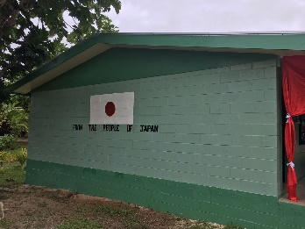
CAKAUDROVE 14
Northern division 3
TAVEUNI 11
Northern division 4
RABI 2
Northern division 5
Vuniwai Rural Water Supply Project (1995)
Two-classroom Building for Nabua Primary School (1995)
Naweni District School Upgrading Project (1996)
Vuanisaiki Primary School Classroom Reconstruction Project (1997)
Upgrading for Nasavusavu District School (1999)
Bridge Construction for Navetau Village (1999)
Provision of Automotive Training Equipment for Montfort Technical Institute (2000)
Construction of New Hostel at Nawi Catholic Primary School (2002)
Provision of Backhoe to Savusavu Town Council (2005)
Provision of Ambulance to Savusavu Hospital (2007)
Project for Upgrading of Kasavu Primary School (2010)
Provision of Garbage Truck to Savusavu Town (2014)
Upgrading of Uluivalili College （2018）
Upgrading of Ratu Emeri Catholic School (2018)
Classroom for Women's Vocational Training for Marist Training Centre (1995)
Niusawa High School Teachers' Quarters Construction Project (1997)
Water Supply Upgrading Project for Wairiki Area (1998)
Upgrading Project for Wainikeli District School (2001)
Upgrading Project for Taveuni Central Indian School (2001)
Upgrading of Niusawa Primary School (2010)
Upgrading of Vuna Primary School (2010)
Upgrading of Taveuni Central Indian School (2010)
Upgrading of South Taveuni Primary School (2013)
Upgrading of Navakawau Catholic School (2014)
Upgrading of Lavena Primary School (2017)
Provision of Ambulance to Rabi Health Centre (2004)
Provision of Garbage Truck to Rabi Island Council (2006)
Labasa
Rabi
Macuata
Bua
Cakaudrove
Savusavu
Taveuni
Nabouwalu

Slide 11
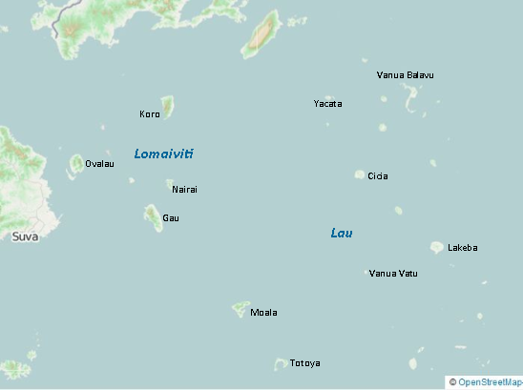
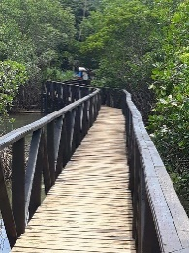
LOMAIVITI 24
Eastern division 1
Motoriki
Yanuca
Tuvua
(Koro)
Improvement of Sanitary Environment in Tuatua (2003)
(Ovalau)
Provision of Garbage Truck for Levuka Town (1993)
Project for Levuka Vakaviti Cable Stayed Bridge (1993)
School Bus for the Levuka Society's School for the Handicapped (1995)
Construction of Two-classrooms building for Delana Methodist Primary School (1995)
Hostel Upgrading for St. John's College (1999)
Sanitary Environment Improvement in Levuka (2001)
Upgrading of Levuka Public Primary School (2002)
Bus for Levuka Society for Handicapped (2003)
Road and Seawall Improvement in Levuka (2003)
Provision of Fire Truck to NFA Levuka Station (2013)
Sanitary Environment Upgrading in Levuka (2013)
School Bus for Levuka Special School (2014)
Upgrading of Levuka Seawall (2015)
(Motoriki)
Water Supply to Nasauvuki Villages (2012)
Water Supply to Savuna Villages(2014)
(Yanuca)
Upgrading of Infrastructure in Yanuca Island(2001)
(Nairai)
Bridge Construction in Tovulailai Village (1999)
Waitonga Village School Upgrading (1999)
(Gau)
Upgrading for Narocake District School (1999)
Upgrading Nawaikama District School (2000)
Upgrading Sawaike District School (2000)
Construction of Nawaikama Foot Crossing (2014)
Upgrading of Sustainable Agriculture in Gau (2014)

Slide 12
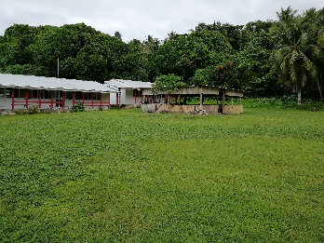
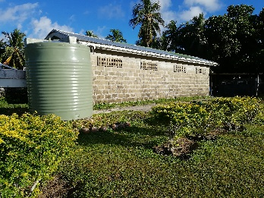
Lau 7
Eastern division 2
Improvement of Water supply for Communities Affected by AMI (2002)
(Yacata)
Water Supply to Yacata Village (2011)
(Tuvua)
Tuvuca Village Water Supply Project (1995)
(Lakebe)
Upgrading Project for Ratu Finau Secondary School (2002)
Lakeba Rural Water Supply Project (1995)
(Moala)
Educational Organizations Upgrading in Naroi Village of Moala Island (1998)
(Totoya)
Upgrading Project for Tovu Village School Footpath (2002)
Motoriki
Yanuca
Tuvua

Slide 13
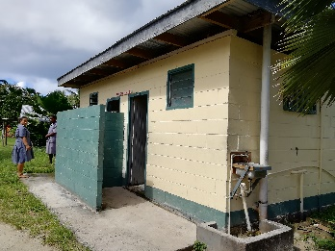
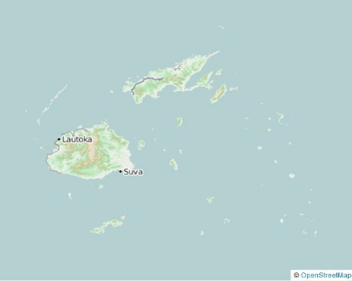
NATIONWIDE or REGIONAL 13
ROTUMA 4
Eastern division 3
Rotuma Hospital Upgrading Project (1998)
Rotuma High School Upgrading Project (1998)
Provision of Ambulance to Rotuma Hospital (2005)
Educational Organizations Upgrading in Rotuma island (2006)
Support Project for 1998 Fiji Careers Expo (1997)
Provision of Hearing &Sight Testing Equipment Project Heaven (1998)
Teacher Training Program of Environmental Education (2000)
Provision of Fire Fighting Vehicle to National Fire Authority (2000)
Project for River Care Education (2002)
Provision of the Blood Donor Services Ambulances & Radio Equipment to Red Cross Society (2002)
Increasing Awareness of AIDS/HIV (2002)
Increasing Awareness of HIV/AIDS in the SPG (2003)
Promotion of Pacific Program for Filariasis (2003)
Increasing Awareness of PacELF (2004)
Electoral Education Support (2014)
Provision of Ballot Boxes (2014)
Upgrading of High Frequency Communications to National Disaster Management Office (2019)
Total No. of Projects: 387
Total Amount Granted: US$26,866,630 (approximately FJ$ 55million)
No. of Education Projects: 219
No. of Water Projects: 32
No. of Environment/Health Projects: 90
No. of Transportation/IT Projects: 36
No. of Agriculture/Fishery Projects: 8
No. of Other Projects: 2
No. of Projects in Central Division: 163
No. of Projects in Western Division: 116
No. of Projects in Northern Division: 71
No. of Projects in Eastern Division: 35
No. of Nationwide Projects: 13
*The total number of projects in each division does not match the total number of projects because some projects ware conducted in multiple regions.
THE REPUBLIC OF FIJI
Vanua Levu
Lomaiviti
Viti Levu
Lau

